Slide 1
Communications During
a Clinical Trial
Notes:
This presentation is based on Chapter 4 of the Communications Handbook for Clinical Trials, which was published in 2010 by FHI 360 and the Microbicides Media and Communications Initiative (MMCI), then housed at PATH . It is part of a series of slide presentations developed by the Preventive Technologies Agreement of FHI 360 in collaboration with the MMCI, which is now coordinated by AVAC. Both the handbook and the presentations were produced with support from the U.S. Agency for International Development.

Slide 2
Overview
This session will cover how to:
Announce your trial
Maintain good communications
Communicate with key stakeholders
Track emerging issues
Prepare for various trial outcomes

Slide 3
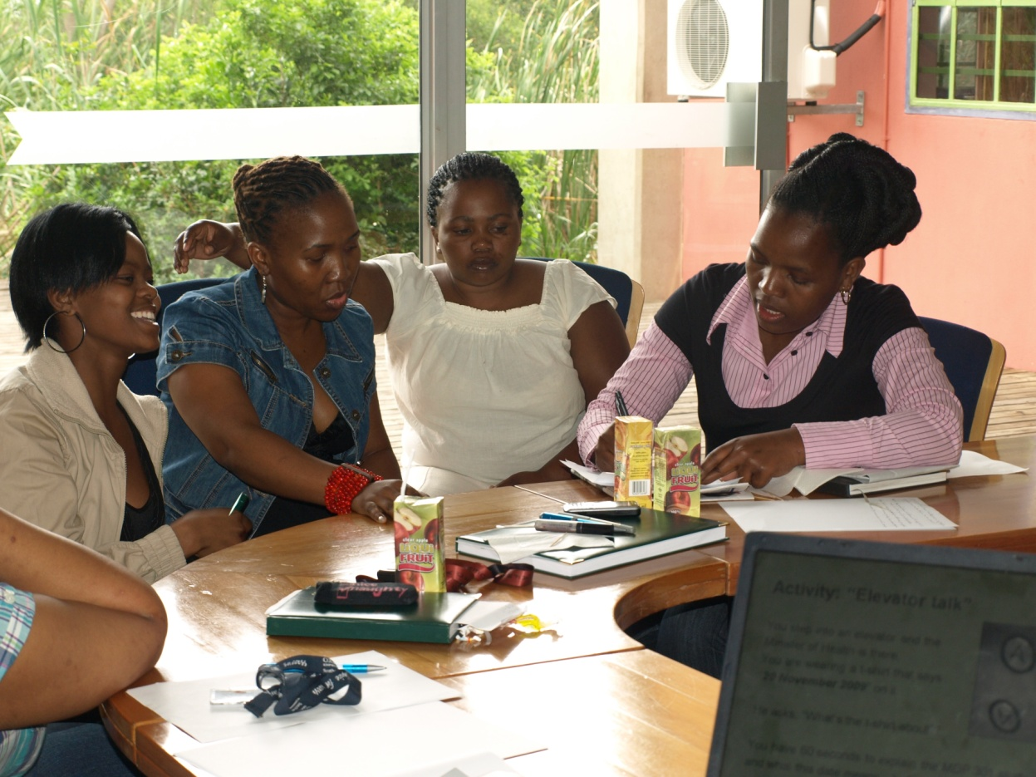
Announcing your Trial Launch
Environmental scans can help you determine how to launch.
Do you want media coverage?
Do you host an event or send out a media release?
Base your launch strategy on the goals and objectives of the trial.
Notes:
A public launch can help build support for a trial, but there are potential drawbacks. Media attention can increase public pressure and heighten expectations for positive results from a trial.
If you are seeking media coverage, consider launching the trial at an upcoming conference or other event that will draw researchers and journalists.
Coordinate your announcement of the trial with all partners, including the government and the sponsor. If you are part of a multisite trial, work closely with staff at headquarters to plan the launch.

Slide 4
Sample Strategies
Early government involvement
MDP 301 (Pro 2000) included the Zambian Minister of Health, generating greater media coverage.
Tiered strategy
VOICE released trial information in waves.
2008-2009: Conference presentations about the study
July 2009: Press release about upcoming study
August 2009: Official announcement of study
September 2009: Announcement and adapted site-level press release about enrollment beginning in Zimbabwe
Notes:
First example: In Mazabuka, Zambia, the fact that the minister of health launched the trial helped build public support and generated greater media coverage.
Second example: The Microbicide Trials Network’s tiered strategy paved the way for a smooth launch of the VOICE trial.

Slide 5
Maintaining Good Communications
Prompt
Polite
Proactive
These three characteristics help build trust. Focus on low-key education over high-publicity activities.
Relationship building is paramount to successful communications efforts. Tone and emotion are just as important as the content of your message.

Slide 6
Communicating with Trial Stakeholders
Keep all stakeholders informed from the beginning—don’t wait for trial milestones.
Show concern for all members of the community and be considerate of different learning styles.
Keep your materials updated.
Create a communications log.
One per site, as well as a central log
Record all communications and review for potential issues.
Notes:
Handout: Tips for ensuring an ongoing dialogue with trial stakeholders, p. 52 of handbook.
A communications log can help you catch potential communications issues. It also helps you document progress and impact. (Handout: Appendix 4.1, Sample template for a monthly summary report on communications)

Slide 7
Communicating with Staff
Staff are ambassadors for your trial. Keep them informed.
Ask staff members to help develop messages about the trial and to report on communications with stakeholders.
Hold regular meetings to provide updates.
Notes:
Types of meetings that can be held to provide updates:
Internal administrative updates
Media and communications update
Scientific update
Refresher training

Slide 8
Other Internal Stakeholders
Institutional review boards
Communications that will reach trial participants
Participants
Regulated by study protocol, but ensure simple language, explained in all official languages used at the site
Funders and sponsors
Status reports, newsletters, conference calls, event invitations
CAB members
Regular meetings and newsletter updates
Notes:
This slide shows other internal stakeholders and ways to communicate with them.
Institutional review boards and other ethics committees generally want to review and approve any communication that will reach potential or enrolled participants during active recruitment. Consult your ethics committee at the beginning of your study and clarify expectations about review of materials.
CAB Members: You should have regular meetings with your community advisory board and any other local groups formed to support the research. Regular meetings will give you opportunities to collaboratively address emerging issues. If you have a newsletter, make sure CAB members receive it.

Slide 9
Reaching External Stakeholders
Ensure regular communication with external stakeholders, based on communications plan. Can include:
Monthly or quarterly newsletters or email updates
Milestones, events, news coverage, photos and graphics
Always include standard language about the study.
Site tours
Photograph the site for educational purposes.
Do not photograph enrolled participants.
Community Media
Some trials have provided training for radio announcers and guests for radio shows.
Notes:
Newsletters: Always include a description of the trial’s specific public health purpose, because recipients often forward e-mails and newsletters to colleagues, who may not know about your trial.
Photographing a study tour is a great way to show stakeholders what the research looks like, but you should be aware that many ethics committees do not allow participants to be photographed during a trial, even if a participant gives his or her permission. Use of such photos could be unintentionally stigmatizing and could cause social harm. For example, community members might assume that the participant in a photo is HIV positive, or a husband might become angry that his wife has joined a study without his knowledge.

Slide 10
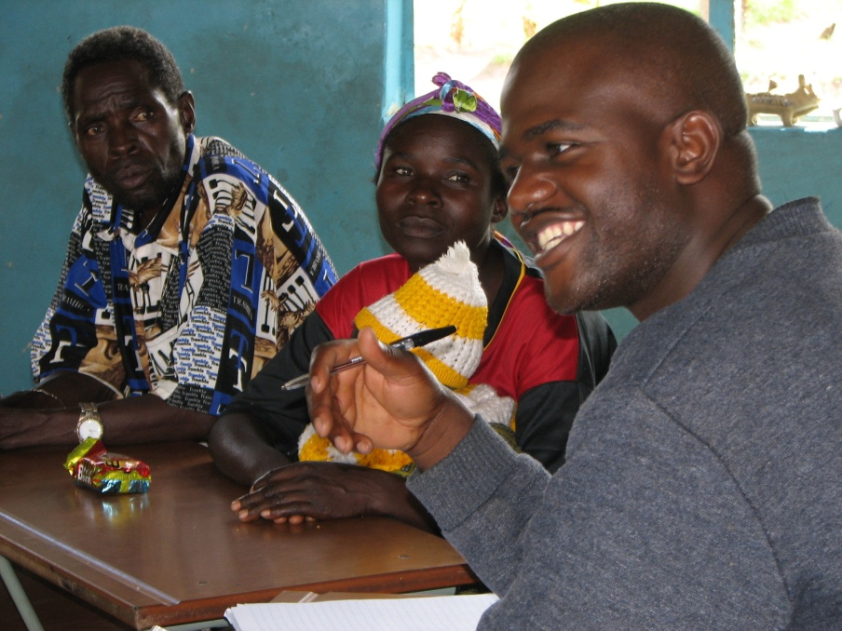
Communicating with External Stakeholders
Community members
Provide regular education.
Be visible in the community.
Include civil society groups.
Be creative: inform and entertain
Governments and ministries
of health
Regular briefing sessions
Frequent written information
Face-to-face meetings with key officials
Continued on next slide
Notes:
Governments and ministries of health: Some studies have scheduled quarterly briefing sessions with MOH officials. Others hold individual meetings with key officials. You may also want to provide regular written updates.
Community members:
Provide regular education. Work with the community educator at each site
and the research team to develop and implement a community education plan. Regular education about the trial and the research process will help you maintain a dialogue with the community and monitor community concerns. Consider providing education about other health topics of interest to the community.
Be creative. Different research sites have used songs, drama and contests to educate communities

Slide 11
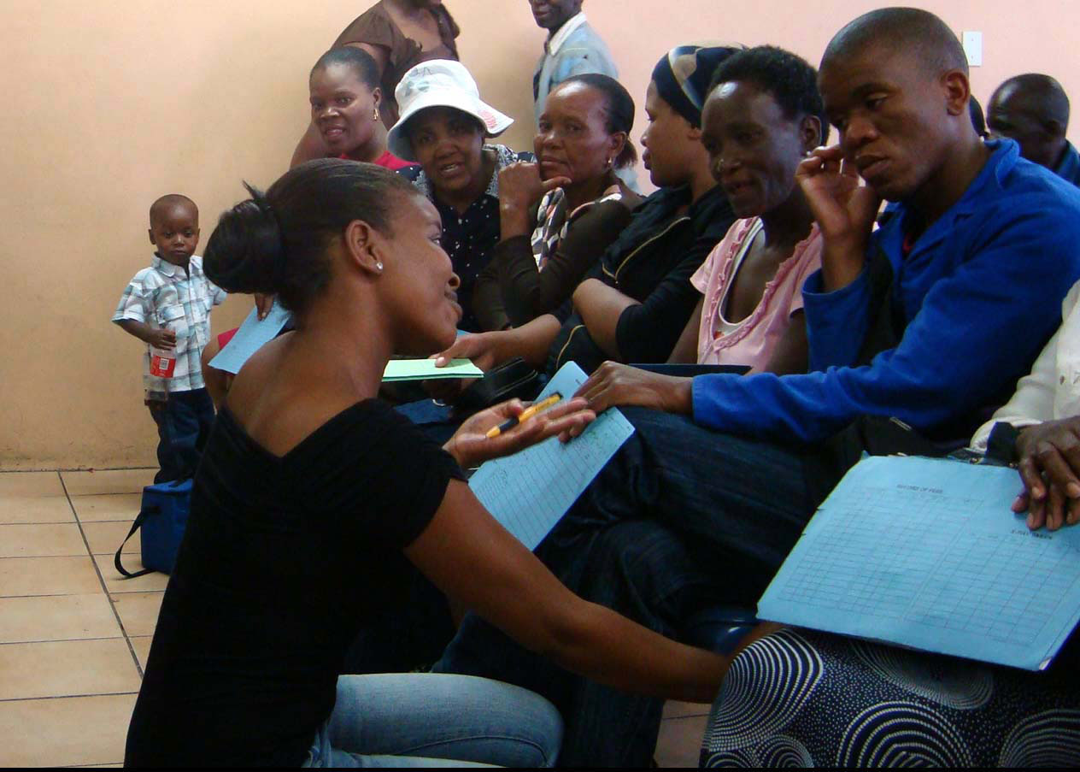
Communicating with External Stakeholders
Scientific community
Newsletters
Listservs and online forums
Regular working groups
Scientific meetings
Media
Identify trusted journalists
Maintain regular contact
Organize events
Notes:
Scientific community: You can use these methods to keep other scientists and public health professionals informed about your trial.
Media: Identify a small group of trusted journalists and keep them updated on the trial. Build relationships with these journalists through regular contact. You also might want to organize events tied to trial milestones, national holidays or anniversaries to engage with a wider group of journalists.

Slide 12
Emerging Issues
Media monitoring
One staff member as primary monitor. All staff members should be on watch when consuming news.
Community monitoring
Hold regular community meetings, listen to participants, detail social harms, use a suggestion box
External monitoring
Provide timely information about any related studies that might affect your trial. Ensure that staff are briefed.
Always pay attention to signs of disquiet among stakeholders.
Notes:
External monitoring: When the results of a related study are released, staff member should be briefed on what to say to participants and community members who ask about it. Participants often hear about other trials through the media. Ensure that staff members are conveying consistent and accurate information by providing them with key messages.

Slide 13
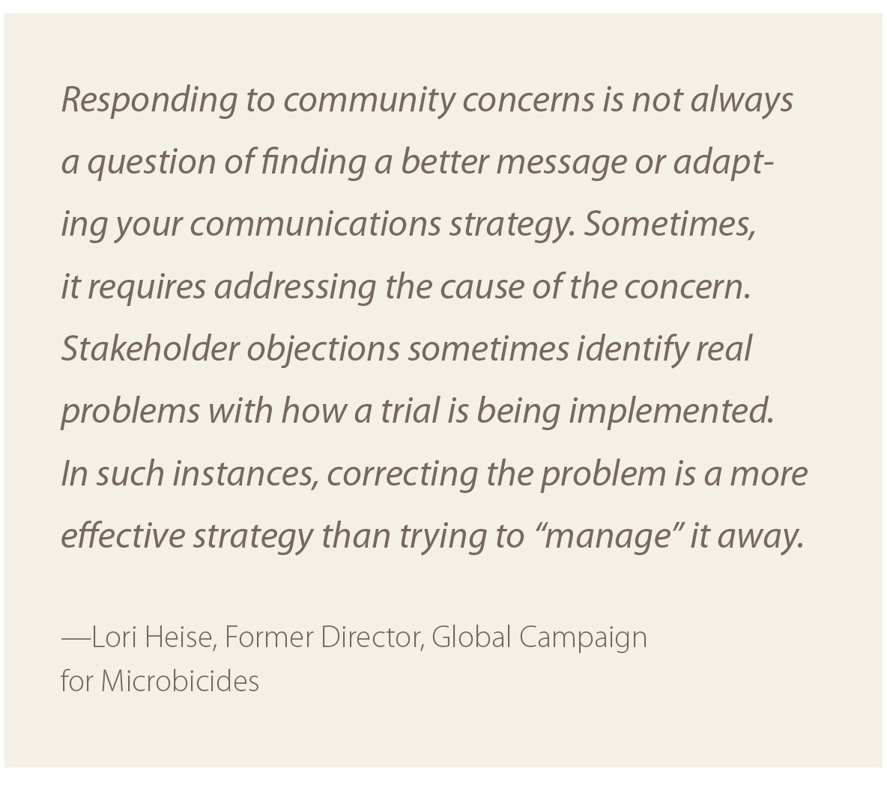
Responding to Stakeholder Concerns
Notes:
Monitoring stakeholder concerns throughout your trial will help you identify any situations or issues that need to be addressed. It is important to do so quickly, before misinformation can spread. Chapter 5 of the Communications Handbook on Clinical Trials and the accompanying slide presentation provide information and tools for managing situations such as unexpected trial closures or negative media coverage of your trial.

Slide 14
Preparing for Interim Analyses and Results
Plan ahead — early closures can happen.
Contact appropriate regulatory bodies, your IRB, trial sponsors and investigators conducting similar studies.
Prepare for all possible outcomes and unexpected scenarios.
Notes:
Most large-scale studies are assessed at regular intervals by an independent data safety and monitoring board (DSMB). These trials are usually well under way before a review board has enough data to identify an efficacy or safety issue, but early closures can happen.
Regulatory authorities, ethics committees, trial sponsors and other investigators conducting similar trials should be informed of the upcoming review. Let them know you will inform them of the DSMB findings and recommendations and will be available to answer questions.

Slide 15
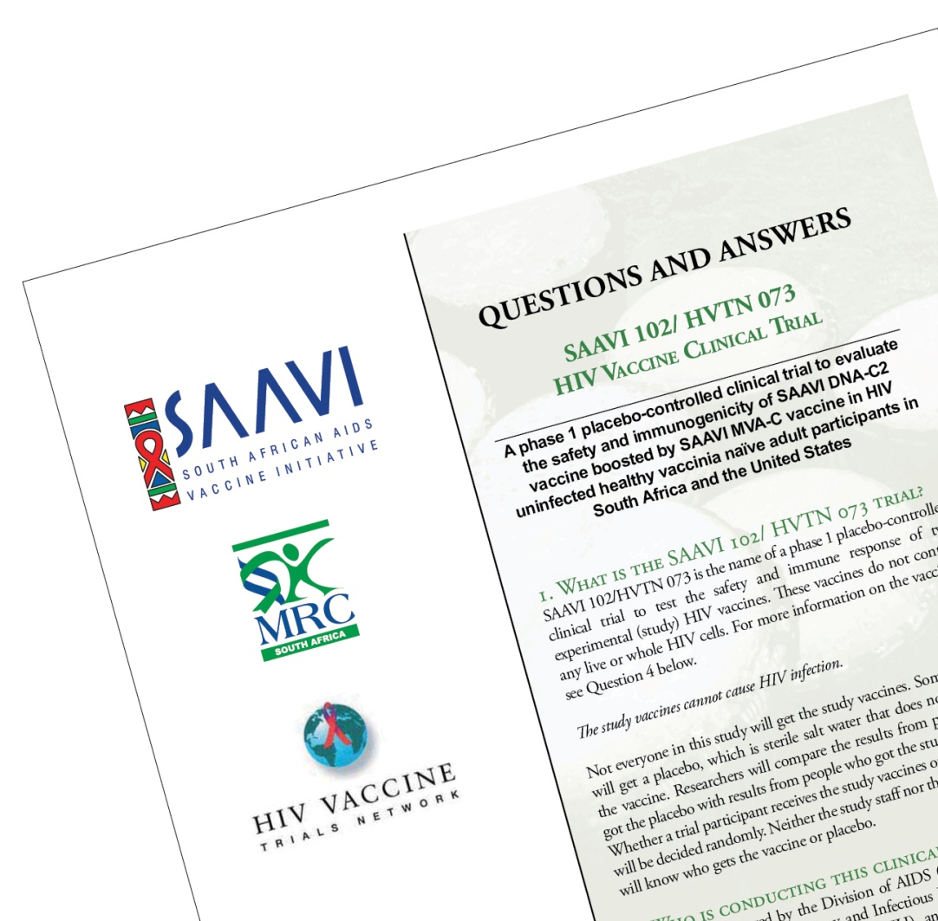
Planning for Various Outcomes
Anticipate positive, neutral and negative scenarios, and describe the implications of each.
How will each scenario change your announcement strategy?
Plan how you would share unexpected results,
based on each scenario identified.
Develop key messages for all
possible scenarios.
An internal Q&A is a
great tool for messaging.
Notes:
Scenario planning: Examples of possible scenarios include that a study continues unchanged, the study continues with modifications recommended by the DSMB or the study is stopped for futility or harm.
The result may change your strategy as well as your messages. For example, you may want to seek media attention for a positive result, but not for a flat one.
Chapter 5 of the Communications Handbook for Clinical Trials and the accompanying slide presentation describes what to do when a study closes unexpectedly. Chapter 6 includes information on scenario planning and details on planning for the dissemination of results at the end of a trial.

Slide 16
Summary
Consider your goals, budget and environment when deciding how to attract media attention and launch your study.
Informed staff and stakeholders are your trial’s most reliable ambassadors.
Monitoring media coverage and stakeholder concerns will help you anticipate and address emerging issues.
Communications should be respectful, transparent and courteous. Never underestimate the importance of tone.
Notes:
Consider your goals: When deciding how to launch your study, weigh the risks and benefits of attracting public and media attention.

Slide 17
For More Information
publications@fhi360.org

